Slide 1



AWS Foundation
Introduction to Cloud Computing
Notes:
Welcome back to the forth module of data science.

Slide 2
Agenda
01
INTRODUCTION TO CLOUD COMPUTING
05
09
Starting off with aws
What is aws?
02
06
10
Virtualization in aws (XEN hypervisor)
Advantages
Aws service domains
03
Cloud Services & deployment models
07
11
Aws services
QUIZ
04
Cloud service providers
08
AWS suite

Slide 3
Introduction to Cloud Computing

Slide 4


Introduction to Cloud Computing?
In the simplest terms, Cloud Computing is when you use a computer/server which is provided to you by someone else.
This server has to be accessed over the internet by using a web-based tool for personal or business use.

Slide 5



Virtualization
Virtualization is the creation of a virtual version of something, such as operating system, server, storage device or network resources.
Running windows on MacOs
Hypervisor
(VMware)
Machine with MacOS
Hypervisor(VMware)

Slide 6


Cloud Computing
Virtualized Compute Environment over internet/intranet is cloud.
Cloud computing = Virtualization + Internet/Intranet

Slide 7
Advantages

Slide 8






Advantages over on-premise
No Capital Expenditure, whatsoever
Provides very high available solutions without any extra effort
Everything is charged on per second/minute/hour basis and pay only if you use
Security
Getting a new server is as easy as clicking some mouse buttons
Flexibility and Error shield

Slide 9
Advantages over on-premise
Y
Maximum Capacity
KEY
Capacity
Capacity which is not used
Capacity used per day
X
Mon
Tue
Wed
Thu
Fri
Sat
Sun

Slide 10
Advantages over on-premise
Y
KEY
Capacity
Capacity which is not used
Capacity used per day
Excess Capacity usage
X
Mon
Tue
Wed
Thu
Fri
Sat
Sun

Slide 11
Advantages over on-premise
Y
KEY
Capacity
Capacity which is not used
Capacity used per day
Excess Capacity usage
X
Mon
Tue
Wed
Thu
Fri
Sat
Sun

Slide 12
Advantages over on-premise
Y
KEY
Capacity
Capacity which is not used
Capacity used per day
Excess Capacity usage
X
Mon
Tue
Wed
Thu
Fri
Sat
Sun

Slide 13
Cloud Service and Deployment Models

Slide 14

















Models and Deployments
Cloud Service Models
IaaS (Infrastructure as a Service): AWS, Rackspace, MS Azure etc.
PaaS (Platform as a Service): AWS Elastic Beanstalk, Heroku etc.
SaaS (Software as a Service): Google drive, Google docs, MS Office 365 etc.
+
+
=
Cooking
Product
Users
Infrastructure
Platform

Slide 15







Models and Deployments
Cloud Service Models
IaaS (Infrastructure as a Service): AWS, Rackspace, MS Azure etc.
PaaS (Platform as a Service): AWS Elastic Beanstalk, Heroku etc.
SaaS (Software as a Service): Google drive, Google docs, MS Office 365 etc.
OS
JVM
+
+
=
Java
Coding
Users
Product
IDE
Infrastructure
Platform

Slide 16
Models and Deployments
Cloud Service Models
IaaS (Infrastructure as a Service): AWS, Rackspace, MS Azure etc.
PaaS (Platform as a Service): AWS Elastic Beanstalk, Heroku etc.
SaaS (Software as a Service): Google drive, Google docs, MS Office 365 etc.
Application
Application
Application
Application
Security
Security
Security
Security
Database
Database
Database
Database
KEY
OS
OS
OS
OS
Available on Premise
Cloud provided
Virtualization
Virtualization
Virtualization
Virtualization
Servers
Servers
Servers
Servers
Storage
Storage
Storage
Storage
Network
Network
Network
Network
Data Center
Data Center
Data Center
Data Center
On-Premise
IaaS
PaaS
SaaS

Slide 17
Models and Deployments
Cloud Service Models
IaaS (Infrastructure as a Service): AWS, Rackspace, MS Azure etc.
PaaS (Platform as a Service): AWS Elastic Beanstalk, Heroku etc.
SaaS (Software as a Service): Google drive, Google docs, MS Office 365 etc.
Cloud Deployment Models
Public Cloud (AWS, MS Azure, Google Platform, IBM Bluemix etc.)
Private Cloud (HPE, VMware, RedHat OpenStack, Dell EMC etc.)
Hybrid Cloud

Slide 18
Cloud Service Providers

Slide 19

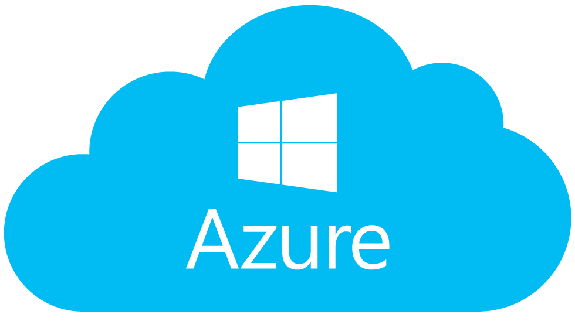

Cloud Service Providers
A Cloud Provider is a company that delivers services and solutions which are based on cloud computing to businesses and/or individuals
Amazon Web Services (AWS)
Microsoft Azure
Google Cloud Platform

Slide 20
Cloud Service Providers
Amazon Web Services
The biggest cloud service provider with 33 zones of availability spread across 17 worldwide regions!
The largest companies in the world like Netflix, Reddit and NSA use AWS to host their applications
Microsoft Azure
2nd biggest market share holder in the cloud computing industry
Azure ranks number in the development and testing tools
Google Cloud Platform
They rank behind AWS and Azure.
They mainly provide SaaS services (Google forms, Google docs)

Slide 21
What is AWS?

Slide 22


What is AWS?
Amazon Web Services provides on-demand cloud computing services to businesses and individuals.
It is owned by Amazon.com and specializes at providing infrastructure as a service
AWS is a platform which helps businesses scale and grow by offering secure cloud services like compute power, content delivery, database storage, and other functionality.

Slide 23

What is AWS?
Competitors for AWS
Amazon Web Services has 2 main competitors right now and they are Microsoft Azure and Google Cloud
Both of them lack behind in experience and the number of services provided
But Azure and Google Cloud are catching up in the race
If you want to choose a cloud provider and you do not know anything about the industry, you place your bets surely on AWS because of their huge experience

Slide 24
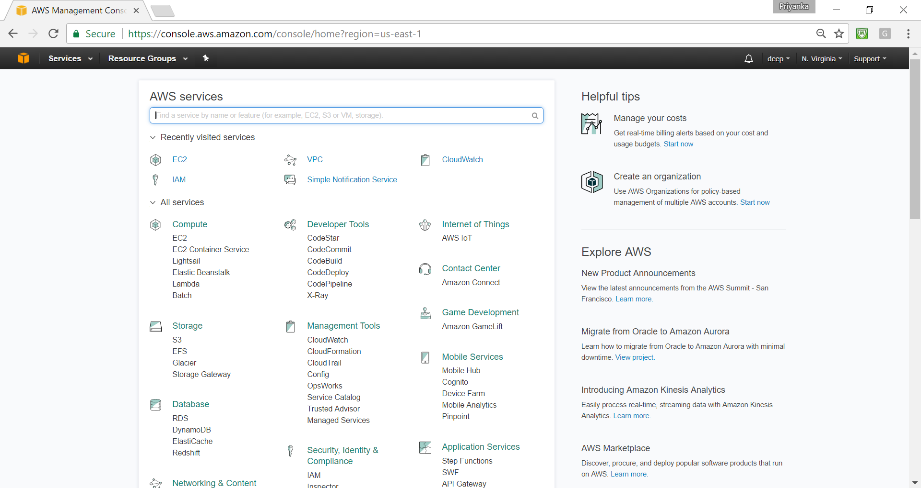
AWS Management Console

Slide 25


Who uses AWS?
World’s largest companies in their own field of work such as Netflix and Samsung use AWS Cloud services

Slide 26
AWS Service Domains

Slide 27




AWS Service Domains
Compute
Storage
Database
Networking

Slide 28
AWS Services

Slide 29
AWS Services
AWS has a rich list of on-demand cloud services to provide, and here are several of the services under the respective service domains.
Compute
EC2
Elastic Beanstalk
Storage
S3
EFS
Database
RDS
DynamoDB
Networking
VPC
CloudFront
Route 53

Slide 30
AWS Suite

Slide 31








AWS Suite
Corporate Data Center
Domain
Monitor
Network
firewall
Notification
Database
Users
Server
Storage

Slide 32











AWS Suite
Route53
CloudWatch
Network
IAM
VPC
Security Groups/NACLS
AWS
SNS
DynamoDB
RDS
EFS
EC2
EBS

Slide 33
Starting off with AWS

Slide 34
Starting off with AWS
Creating an AWS account
Open AWS website - https://aws.amazon.com/
Click on create an AWS account
Type all the required details and give continue
In the Payment page, provide your card details to authenticate your account (2 INR will be debited and refunded back after authentication)
Now Login and open the AWS management console
You are now ready begin with hands-on in the further modules

Slide 35
Virtualization in AWS

Slide 36



Virtualization in AWS
Types of Hypervisor
TYPE-2 (Hosted)
TYPE-1 (Native/Bare Metal)
Redhat Linux
Hardware
OS
Hypervisor
MS Windows
Redhat Linux
MS Windows
Hardware
Hypervisor

Slide 37
XEN Hypervisor
Xen Project is a hypervisor using microkernel design
Was launched in October 2003 by University of Cambridge Computer Laboratory
Leading open source virtualization platform which is powering the biggest players in cloud today
AWS, RackSpace, OpenStack, Verizon Cloud etc. use Xen
For more information visit – https://www.xenproject.org
KVM is also used in some places

Slide 38
Summary
In the simplest terms, Cloud Computing is storing and accessing data and programs over the internet
Few benefits of cloud computing are Better scalability and improved security are
Deployment and service models
AWS services – Compute, Networking, Storage and Database
Major cloud providers – AWS, Azure and GCP

Slide 39
Quiz

Slide 40
Quiz
1. "Cloud" in cloud computing represents what?
Wireless
Hard drives
People
Internet

Slide 41
Quiz
2. Which one of these is not a cloud computing pricing model?
Free
Pay per use
Subscription
Ladder

Slide 42
Quiz
3. What is the name of AWS compute services?
Virtual Machine
EC2
AMI
EIP

Slide 43
Quiz
4. At least how many availability Zone regions can be there?
2
3
Depending on the region
EIP

Slide 44
Quiz
5. What is the name of AWS Object based Storage service?
EBS
BLOB
S3
EFS

Slide 45

India : +91-7847955955
US : 1-800-216-8930 (TOLL FREE)
support@intellipaat.com
24X7 Chat with our Course Advisor
Notes:
Thank you!

